Slide 1
05-Internetworking -3 (Chapter 3)

Slide 2
ICMP: internet control message protocol
used by hosts & routers to communicate network-level information
error reporting: unreachable host, network, port, protocol
echo request/reply (used by ping)
network-layer “above” IP:
ICMP msgs carried in IP datagrams
ICMP message: type, code plus first 8 bytes of IP datagram causing error
Type Code description
0 0 echo reply (ping)
3 0 dest. network unreachable
3 1 dest host unreachable
3 2 dest protocol unreachable
3 3 dest port unreachable
3 6 dest network unknown
3 7 dest host unknown
4 0 source quench (congestion
control - not used)
8 0 echo request (ping)
9 0 route advertisement
10 0 router discovery
11 0 TTL expired
12 0 bad IP header

Slide 3

Traceroute and ICMP
source sends series of UDP segments to dest
first set has TTL =1
second set has TTL=2, etc.
unlikely port number
when nth set of datagrams arrives to nth router:
router discards datagrams
and sends source ICMP messages (type 11, code 0)
ICMP messages includes name of router & IP address
when ICMP messages arrives, source records RTTs
stopping criteria:
UDP segment eventually arrives at destination host
destination returns ICMP “port unreachable” message (type 3, code 3)
source stops
3 probes
3 probes
3 probes

Slide 4
IPv6: motivation
initial motivation: 32-bit address space soon to be completely allocated.
additional motivation:
header format helps speed processing/forwarding
header changes to facilitate QoS
IPv6 datagram format:
fixed-length 40 byte header
no fragmentation allowed

Slide 5
IPv6 datagram format
priority: identify priority among datagrams in flow
flow Label: identify datagrams in same “flow.”
(concept of“flow” not well defined).
next header: identify upper layer protocol for data
ver
pri
flow label
payload len
next hdr
hop limit
source address
(128 bits)
destination address
(128 bits)
data
32 bits

Slide 6
Other changes from IPv4
checksum: removed entirely to reduce processing time at each hop
options: allowed, but outside of header, indicated by “Next Header” field
ICMPv6: new version of ICMP
additional message types, e.g. “Packet Too Big”
multicast group management functions

Slide 7
Transition from IPv4 to IPv6
not all routers can be upgraded simultaneously
no “flag days”
how will network operate with mixed IPv4 and IPv6 routers?
tunneling: IPv6 datagram carried as payload in IPv4 datagram among IPv4 routers
IPv4 header fields
IPv6 header fields
IPv4 payload
IPv4 source, dest addr
IPv6 source dest addr
UDP/TCP payload
IPv6 datagram
IPv4 datagram

Slide 8
Tunneling
A
B
IPv4 tunnel
connecting IPv6 routers
E
F
logical view:
IPv6
IPv6
IPv6
IPv6
A
B
C
D
E
F
physical view:
IPv6
IPv6
IPv4
IPv4
IPv6
IPv6

Slide 9
Tunneling
A
B
IPv4 tunnel
connecting IPv6 routers
E
F
logical view:
IPv6
IPv6
IPv6
IPv6
A
B
C
D
E
F
physical view:
IPv6
IPv6
IPv4
IPv4
IPv6
IPv6
flow: X
src: A
dest: F
data
src:B
dest: E
src:B
dest: E
flow: X
src: A
dest: F
data
Flow: X
Src: A
Dest: F
data
Flow: X
Src: A
Dest: F
data
A-to-B:
IPv6
B-to-C:
IPv6 inside
IPv4
B-to-C:
IPv6 inside
IPv4
E-to-F:
IPv6

Slide 10
Interplay between routing, forwarding
routing algorithm determines
end-end-path through network
routing algorithm
forwarding table determines
local forwarding at this router
local forwarding table
dest address
output link
address-range 1
address-range 2
address-range 3
address-range 4
3
2
2
1
IP destination address in
arriving packet’s header
1
3
2

Slide 11
Graph abstraction
5
v
3
w
2
5
u
2
1
z
3
1
2
x
y
1
graph: G = (N,E)
N = set of routers = { u, v, w, x, y, z }
E = set of links ={ (u,v), (u,x), (v,x), (v,w), (x,w), (x,y), (w,y), (w,z), (y,z) }
aside: graph abstraction is useful in other network contexts, e.g.,
P2P, where N is set of peers and E is set of TCP connections

Slide 12
Graph abstraction: costs
5
c(x,x’) = cost of link (x,x’)
e.g., c(w,z) = 5
cost could always be 1, or
inversely related to bandwidth,
or inversely related to
congestion
v
3
w
2
5
u
2
1
z
3
1
2
x
y
1
cost of path (x₁, x₂, x₃,…, x_{p}) = c(x₁,x₂) + c(x₂,x₃) + … + c(x_{p-1},x_{p})
key question: what is the least-cost path between u and z ?
routing algorithm: algorithm that finds that least cost path

Slide 13
Routing algorithm classification
Q: global or decentralized information?
global:
all routers have complete topology, link cost info
“link state” algorithms
decentralized:
router knows physically-connected neighbors, link costs to neighbors
iterative process of computation, exchange of info with neighbors
“distance vector” algorithms
Q: static or dynamic?
static:
routes change slowly over time
dynamic:
routes change more quickly
periodic update
in response to link cost changes

Slide 14
A Link-State Routing Algorithm
Dijkstra’s algorithm
net topology, link costs known to all nodes
accomplished via “link state broadcast”
all nodes have same info
computes least cost paths from one node (‘source”) to all other nodes
gives forwarding table for that node
iterative: after k iterations, know least cost path to k dest.’s
notation:
c(x,y): link cost from node x to y; = ∞ if not direct neighbors
D(v): current value of cost of path from source to dest. v
p(v): predecessor node along path from source to v
N': set of nodes whose least cost path definitively known

Slide 15
Dijsktra’s Algorithm
1 Initialization:
2 N' = {u}
3 for all nodes v
4 if v adjacent to u
5 then D(v) = c(u,v)
6 else D(v) = ∞
7
8 Loop
9 find w not in N' such that D(w) is a minimum
10 add w to N'
11 update D(v) for all v adjacent to w and not in N' :
12 D(v) = min( D(v), D(w) + c(w,v) )
13 /* new cost to v is either old cost to v or known
14 shortest path cost to w plus cost from w to v */
15 until all nodes in N'

Slide 16
Dijkstra’s algorithm: example
D(v)
p(v)
D(w)
p(w)
D(x)
p(x)
D(y)
p(y)
D(z)
p(z)
Step
N'
0
u
7,u
3,u
5,u
∞
∞
1
uw
6,w
5,u
11,w
∞
2
uwx
6,w
11,w
14,x
3
uwxv
10,v
14,x
4
uwxvy
12,y
5
uwxvyz
x
9
notes:
construct shortest path tree by tracing predecessor nodes
ties can exist (can be broken arbitrarily)
5
7
4
8
u
3
w
y
z
2
3
7
4
v

Slide 17
Dijkstra’s algorithm: another example
Step
0
1
2
3
4
5
N'
u
ux
uxy
uxyv
uxyvw
uxyvwz
D(v),p(v)
2,u
2,u
2,u
D(w),p(w)
5,u
4,x
3,y
3,y
D(x),p(x)
1,u
D(y),p(y)
∞
2,x
D(z),p(z)
∞
∞
4,y
4,y
4,y
5
v
3
w
2
5
u
2
1
z
3
1
2
x
y
1

Slide 18
Dijkstra’s algorithm: example (2)
resulting shortest-path tree from u:
v
w
u
z
x
y
resulting forwarding table in u:
destination
link
v
(u,v)
x
(u,x)
y
(u,x)
w
(u,x)
z
(u,x)

Slide 19
Distance vector algorithm
Bellman-Ford equation (dynamic programming)
let
D_{x}(y) := cost of least-cost path from x to y
then
D_{x}(y) = min {c(x,v) + D_{v}(y) }
v
cost from neighbor v to destination y
cost to neighbor v
min taken over all neighbors v of x

Slide 20
Bellman-Ford example
5
clearly, D_{v}(z) = 5, D_{x}(z) = 3, D_{w}(z) = 3
v
3
w
2
5
u
z
B-F equation says:
2
1
3
1
2
D_{u}(z) = min { c(u,v) + D_{v}(z),
c(u,x) + D_{x}(z),
c(u,w) + D_{w}(z) }
x
y
1
= min {2 + 5,
1 + 3,
5 + 3} = 4
node achieving minimum is next hop in shortest path,
used in forwarding table

Slide 21
Distance vector algorithm
D_{x}(y) = estimate of least cost from x to y
x maintains distance vector D_{x} = [D_{x}(y): y є N ]
node x:
knows cost to each neighbor v: c(x,v)
maintains its neighbors’ distance vectors. For each neighbor v, x maintains D_{v} = [D_{v}(y): y є N ]

Slide 22
Distance vector algorithm
key idea:
from time-to-time, each node sends its own distance vector estimate to neighbors
when x receives new DV estimate from neighbor, it updates its own DV using B-F equation:
D_{x}(y) ← min_{v}{c(x,v) + D_{v}(y)} for each node y ∊ N
under minor, natural conditions, the estimate D_{x}(y) converge to the actual least cost D_{x}(y)

Slide 23
Distance vector algorithm
iterative, asynchronous: each local iteration caused by:
local link cost change
DV update message from neighbor
distributed:
each node notifies neighbors only when its DV changes
neighbors then notify their neighbors if necessary
each node:
wait for (change in local link cost or msg from neighbor)
recompute estimates
if DV to any dest has changed, notify neighbors

Slide 24
D_{x}(z) = min{c(x,y) + D_{y}(z), c(x,z) + D_{z}(z)}
= min{2+1 , 7+0} = 3
D_{x}(y) = min{c(x,y) + D_{y}(y), c(x,z) + D_{z}(y)} = min{2+0 , 7+1} = 2
node x
table
cost to
cost to
x y z
x y z
x
0 2 7
x
0
2
3
y
y
2 0 1
from
∞
∞
∞
from
z
∞
∞
∞
z
7 1 0
node y
table
cost to
x y z
y
2
1
x
∞
∞
z
∞
2 0 1
x
from
y
7
z
∞
∞
∞
node z
table
cost to
x y z
x
∞ ∞ ∞
from
y
∞
∞
∞
z
7
1
0
time

Slide 25
D_{x}(z) = min{c(x,y) + D_{y}(z), c(x,z) + D_{z}(z)}
= min{2+1 , 7+0} = 3
D_{x}(y) = min{c(x,y) + D_{y}(y), c(x,z) + D_{z}(y)} = min{2+0 , 7+1} = 2
node x
table
cost to
cost to
cost to
x y z
x y z
x y z
x
0 2 7
x
0
2
3
x
0 2 3
y
y
2 0 1
from
∞
∞
∞
from
y
2 0 1
z
z
from
∞
∞
∞
7 1 0
z
3 1 0
node y
table
cost to
cost to
cost to
x y z
x y z
x y z
y
2
1
x
∞
∞
x
0 2 7
∞
2 0 1
x
0 2 3
x
z
from
y
y
2 0 1
y
7
from
from
2 0 1
z
∞
∞
∞
z
7 1 0
z
3 1 0
node z
table
cost to
cost to
cost to
x y z
x y z
x y z
x
∞ ∞ ∞
x
0 2 7
x
0 2 3
y
y
2 0 1
from
y
∞
∞
from
2 0 1
from
∞
z
z
3 1 0
z
3 1 0
7
1
0
time
time

Slide 26
Distance vector: link cost changes
link cost changes:
node detects local link cost change
updates routing info, recalculates distance vector
if DV changes, notify neighbors
1
y
4
1
x
z
50
“good
news
travels
fast”
t₀ : y detects link-cost change, updates its DV, informs its neighbors.
t₁ : z receives update from y, updates its table, computes new least cost to x , sends its neighbors its DV.
t₂ : y receives z’s update, updates its distance table. y’s least costs do not change, so y does not send a message to z.

Slide 27
Distance vector: link cost changes
link cost changes:
node detects local link cost change
bad news travels slow - “count to infinity” problem!
44 iterations before algorithm stabilizes: see text
60
y
4
1
x
z
50
poisoned reverse:
If Z routes through Y to get to X :
Z tells Y its (Z’s) distance to X is infinite (so Y won’t route to X via Z)
will this completely solve count to infinity problem?

Slide 28
Comparison of LS and DV algorithms
message complexity
LS: with n nodes, E links, O(nE) msgs sent
DV: exchange between neighbors only
convergence time varies
speed of convergence
LS: O(n²) algorithm requires O(nE) msgs
may have oscillations
DV: convergence time varies
may be routing loops
count-to-infinity problem
robustness: what happens if router malfunctions?
LS:
node can advertise incorrect link cost
each node computes only its own table
DV:
DV node can advertise incorrect path cost
each node’s table used by others
error propagate thru network

Slide 29
Hierarchical routing
our routing study thus far - idealization
all routers identical
network “flat”
… not true in practice
scale: with 600 million destinations:
can’t store all dest’s in routing tables!
routing table exchange would swamp links!
administrative autonomy
internet = network of networks
each network admin may want to control routing in its own network

Slide 30
Hierarchical routing
aggregate routers into regions, “autonomous systems” (AS)
routers in same AS run same routing protocol
“intra-AS” routing protocol
routers in different AS can run different intra-AS routing protocol
gateway router:
at “edge” of its own AS
has link to router in another AS

Slide 31
Interconnected ASes
3c
3a
2c
3b
AS3
2a
1c
2b
AS2
1a
1b
1d
AS1
forwarding table configured by both intra- and inter-AS routing algorithm
intra-AS sets entries for internal dests
inter-AS & intra-AS sets entries for external dests
Intra-AS
Routing
algorithm
Inter-AS
Routing
algorithm
Forwarding
table

Slide 32
Inter-AS tasks
suppose router in AS1 receives datagram destined outside of AS1:
router should forward packet to gateway router, but which one?
AS1 must:
learn which dests are reachable through AS2, which through AS3
propagate this reachability info to all routers in AS1
job of inter-AS routing!
3c
3a
3b
AS3
2c
other
networks
1c
2a
other
networks
1a
2b
1b
AS2
AS1
1d

Slide 33
Example: setting forwarding table in router 1d
suppose AS1 learns (via inter-AS protocol) that subnet x reachable via AS3 (gateway 1c), but not via AS2
inter-AS protocol propagates reachability info to all internal routers
router 1d determines from intra-AS routing info that its interface I is on the least cost path to 1c
installs forwarding table entry (x,I)
…
x
3c
3a
3b
AS3
2c
other
networks
1c
2a
other
networks
1a
2b
1b
AS2
AS1
1d

Slide 34
Example: choosing among multiple ASes
now suppose AS1 learns from inter-AS protocol that subnet x is reachable from AS3 and from AS2.
to configure forwarding table, router 1d must determine which gateway it should forward packets towards for dest x
this is also job of inter-AS routing protocol!
…
x
3c
……
3a
3b
AS3
2c
other
networks
1c
2a
other
networks
1a
2b
1b
AS2
AS1
1d
?

Slide 35
Example: choosing among multiple ASes
now suppose AS1 learns from inter-AS protocol that subnet x is reachable from AS3 and from AS2.
to configure forwarding table, router 1d must determine towards which gateway it should forward packets for dest x
this is also job of inter-AS routing protocol!
hot potato routing: send packet towards closest of two routers.
use routing info
from intra-AS
protocol to determine
costs of least-cost
paths to each
of the gateways
determine from
forwarding table the
interface I that leads
to least-cost gateway.
Enter (x,I) in
forwarding table
learn from inter-AS
protocol that subnet
x is reachable via
multiple gateways
hot potato routing:
choose the gateway
that has the
smallest least cost

Slide 36
Intra-AS Routing
also known as interior gateway protocols (IGP)
most common intra-AS routing protocols:
RIP: Routing Information Protocol
OSPF: Open Shortest Path First
IGRP: Interior Gateway Routing Protocol (Cisco proprietary)

Slide 37
RIP ( Routing Information Protocol)
included in BSD-UNIX distribution in 1982
distance vector algorithm
distance metric: # hops (max = 15 hops), each link has cost 1
DVs exchanged with neighbors every 30 sec in response message (aka advertisement)
each advertisement: list of up to 25 destination subnets (in IP addressing sense)
from router A to destination subnets:
u
v
subnet hops
u 1
v 2
w 2
x 3
y 3
z 2
A
B
w
x
z
C
D
y

Slide 38
RIP: example
z
w
x
y
A
D
B
C
routing table in router D
destination subnet next router # hops to dest
w A 2
y B 2
z B 7
x -- 1
…. …. ....

Slide 39
RIP: example
A-to-D advertisement
dest next hops
w - 1
x - 1
z C 4
…. … ...
z
w
x
y
A
D
B
C
routing table in router D
destination subnet next router # hops to dest
w A 2
y B 2
z B 7
x -- 1
…. …. ....
A
5

Slide 40
RIP: link failure, recovery
if no advertisement heard after 180 sec --> neighbor/link declared dead
routes via neighbor invalidated
new advertisements sent to neighbors
neighbors in turn send out new advertisements (if tables changed)
link failure info quickly (?) propagates to entire net
poison reverse used to prevent ping-pong loops (infinite distance = 16 hops)

Slide 41
RIP table processing
RIP routing tables managed by application-level process called route-d (daemon)
advertisements sent in UDP packets, periodically repeated
routed
routed
transport
(UDP)
transprt
(UDP)
network forwarding
(IP) table
network
(IP)
forwarding
table
link
link
physical
physical

Slide 42
OSPF (Open Shortest Path First)
“open”: publicly available
uses link state algorithm
LS packet dissemination
topology map at each node
route computation using Dijkstra’s algorithm
OSPF advertisement carries one entry per neighbor
advertisements flooded to entire AS
carried in OSPF messages directly over IP (rather than TCP or UDP
IS-IS routing protocol: nearly identical to OSPF

Slide 43
OSPF “advanced” features (not in RIP)
security: all OSPF messages authenticated (to prevent malicious intrusion)
multiple same-cost paths allowed (only one path in RIP)
for each link, multiple cost metrics for different TOS (e.g., satellite link cost set “low” for best effort ToS; high for real time ToS)
integrated uni- and multicast support:
Multicast OSPF (MOSPF) uses same topology data base as OSPF
hierarchical OSPF in large domains.

Slide 44
Hierarchical OSPF
boundary router
backbone router
backbone
area
border
routers
area 3
internal
routers
area 1
area 2

Slide 45
Hierarchical OSPF
two-level hierarchy: local area, backbone.
link-state advertisements only in area
each nodes has detailed area topology; only know direction (shortest path) to nets in other areas.
area border routers: “summarize” distances to nets in own area, advertise to other Area Border routers.
backbone routers: run OSPF routing limited to backbone.
boundary routers: connect to other AS’s.

Slide 46
Internet inter-AS routing: BGP
BGP (Border Gateway Protocol): the de facto inter-domain routing protocol
“glue that holds the Internet together”
BGP provides each AS a means to:
eBGP: obtain subnet reachability information from neighboring ASs.
iBGP: propagate reachability information to all AS-internal routers.
determine “good” routes to other networks based on reachability information and policy.
allows subnet to advertise its existence to rest of Internet: “I am here”

Slide 47
BGP basics
BGP session: two BGP routers (“peers”) exchange BGP messages:
advertising paths to different destination network prefixes (“path vector” protocol)
exchanged over semi-permanent TCP connections
when AS3 advertises a prefix to AS1:
AS3 promises it will forward datagrams towards that prefix
AS3 can aggregate prefixes in its advertisement
3c
3a
BGP
message
3b
AS3
2c
other
networks
1c
2a
other
networks
1a
2b
1b
AS2
AS1
1d

Slide 48
BGP basics: distributing path information
using eBGP session between 3a and 1c, AS3 sends prefix reachability info to AS1.
1c can then use iBGP do distribute new prefix info to all routers in AS1
1b can then re-advertise new reachability info to AS2 over 1b-to-2a eBGP session
when router learns of new prefix, it creates entry for prefix in its forwarding table.
eBGP session
3a
3b
iBGP session
AS3
2c
other
networks
1c
2a
other
networks
1a
2b
1b
AS2
AS1
1d

Slide 49
Path attributes and BGP routes
advertised prefix includes BGP attributes
prefix + attributes = “route”
two important attributes:
AS-PATH: contains ASs through which prefix advertisement has passed: e.g., AS 67, AS 17
NEXT-HOP: indicates specific internal-AS router to next-hop AS. (may be multiple links from current AS to next-hop-AS)
gateway router receiving route advertisement uses import policy to accept/decline
e.g., never route through AS x
policy-based routing

Slide 50
BGP route selection
router may learn about more than 1 route to destination AS, selects route based on:
local preference value attribute: policy decision
shortest AS-PATH
closest NEXT-HOP router: hot potato routing
additional criteria

Slide 51
BGP messages
BGP messages exchanged between peers over TCP connection
BGP messages:
OPEN: opens TCP connection to peer and authenticates sender
UPDATE: advertises new path (or withdraws old)
KEEPALIVE: keeps connection alive in absence of UPDATES; also ACKs OPEN request
NOTIFICATION: reports errors in previous msg; also used to close connection

Slide 52
BGP routing policy
legend:
provider
B
network
X
W
A
customer
C
network:
Y
A,B,C are provider networks
X,W,Y are customer (of provider networks)
X is dual-homed: attached to two networks
X does not want to route from B via X to C
.. so X will not advertise to B a route to C

Slide 53
BGP routing policy (2)
legend:
provider
B
network
X
W
A
customer
C
network:
Y
A advertises path AW to B
B advertises path BAW to X
Should B advertise path BAW to C?
No way! B gets no “revenue” for routing CBAW since neither W nor C are B’s customers
B wants to force C to route to w via A
B wants to route only to/from its customers!

Slide 54
Why different Intra-, Inter-AS routing ?
policy:
inter-AS: admin wants control over how its traffic routed, who routes through its net.
intra-AS: single admin, so no policy decisions needed
scale:
hierarchical routing saves table size, reduced update traffic
performance:
intra-AS: can focus on performance
inter-AS: policy may dominate over performance

Slide 55
Bridges and LAN Switches
Bridges/ LAN Switches
Used to forward packets between shared-media LANs such as Ethernets
Suppose you have a pair of Ethernets that you want to interconnect
One approach is put a repeater in between them
It might exceed the physical limitation of the Ethernet
No more than four repeaters between any pair of hosts
No more than a total of 2500 m in length is allowed
An alternative: Bridges/LAN Switches
Extended LAN

Slide 56
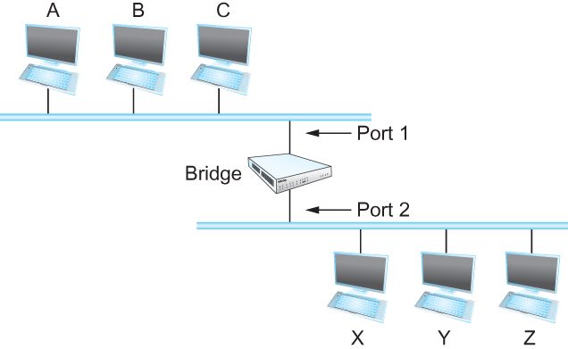
Switches
Simplest Strategy for Switches
Accept LAN frames on their inputs and forward them out to all other outputs
Self-Learning Switches
Observe that there is no need to forward all the frames that a bridge receives
Host Port
--------------------
A 1
B 1
C 1
X 2
Y 2
Z 2

Slide 57
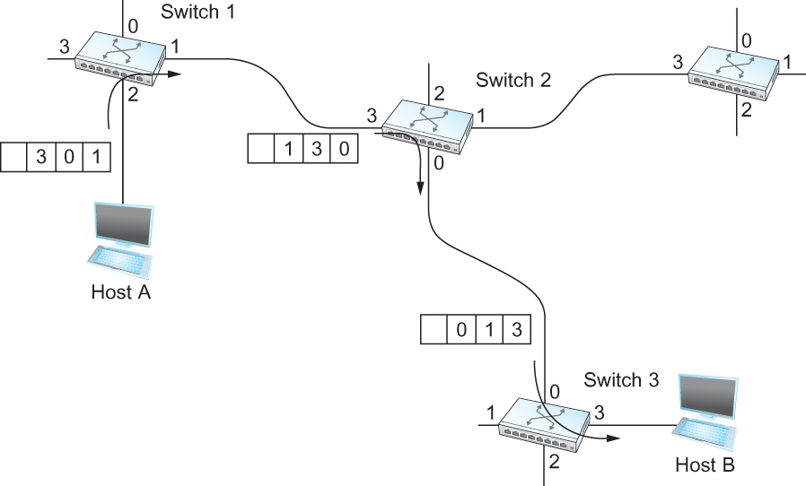
Source Routing
All the information about network topology that is required to switch a packet across the network is provided by the source host

Slide 58
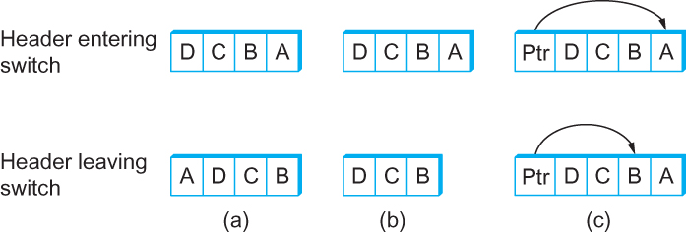
Source Routing-2
Other approaches in Source Routing

